Slide 1
Twisting Fate
Storyboard

Slide 2




Twisting Fate
Start
Exit
Notes:
Game Start

Slide 3
Choose your Subject._
BLOCKED
ENVIRONMENT
BLOCKED
Notes:
Game Start

Slide 4
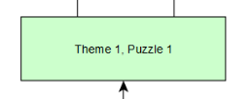
Notes:
Level Select

Slide 5
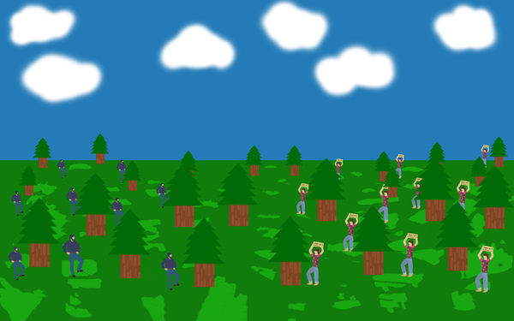

Notes:
Level Select

Slide 6
Notes:
Game Screen
FATE’s Eye move to look at the player
Hint system

Slide 7
Should Humanity be saved?_
Yes
No
Notes:
Should we save humanity

Slide 8
Are you Sure?_
Yes
No
Notes:
Last Question

Slide 9
Notes:
End Frame X - Base frame for all endings

Slide 10
Notes:
Bad End - Frame 1 - Star Explodes

Slide 11

Notes:
Bad End - Frame 2

Slide 12

Notes:
Bad End - Frame 3

Slide 13

Notes:
Bad End - Frame 3

Slide 14
Notes:
End Frame X - Base frame for all endings

Slide 15
Notes:
Good End - Frame 1

Slide 16
Notes:
Good End - Frame 2

Slide 17
Notes:
Good End - Frame 3

Slide 18
Notes:
Good End - Frame 3

